Slide 1
SNAP AND SEARCH
Searching RE-DEFINED

Slide 2
Project Definition
Project is about Image based search engine which shall find similar products from well-known E-commerce websites.

Slide 3
Project Domain
Dynamic GUI with Android Programming
Image Processing
J2EE
Image Comparison
Database

Slide 4
Current Scenario
Currently, Google and TinEye provide the facilities to Search by Images.
Results Google and TinEye provide are quite difficult to assess as they provide Generalized Search Results.
There are many Excessive Results which confuse user with unrelated information regarding the product.

Slide 5
Evolution
Current scenario limits the user with generalized results.
Development being done shall connect e-commerce with this domain.
Application shall allow user to get access to more precise details and look alike products.
User then can buy the product(s) with help of result being displayed.

Slide 6
Scope
Search Area to be Limited to Watches
Use of Existing Image Processing and Comparison Algorithms
Database Management System
Image Crawling
Development of Interactive GUI

Slide 7
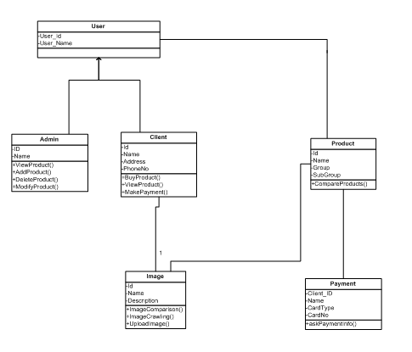
Class Diagram:

Slide 8
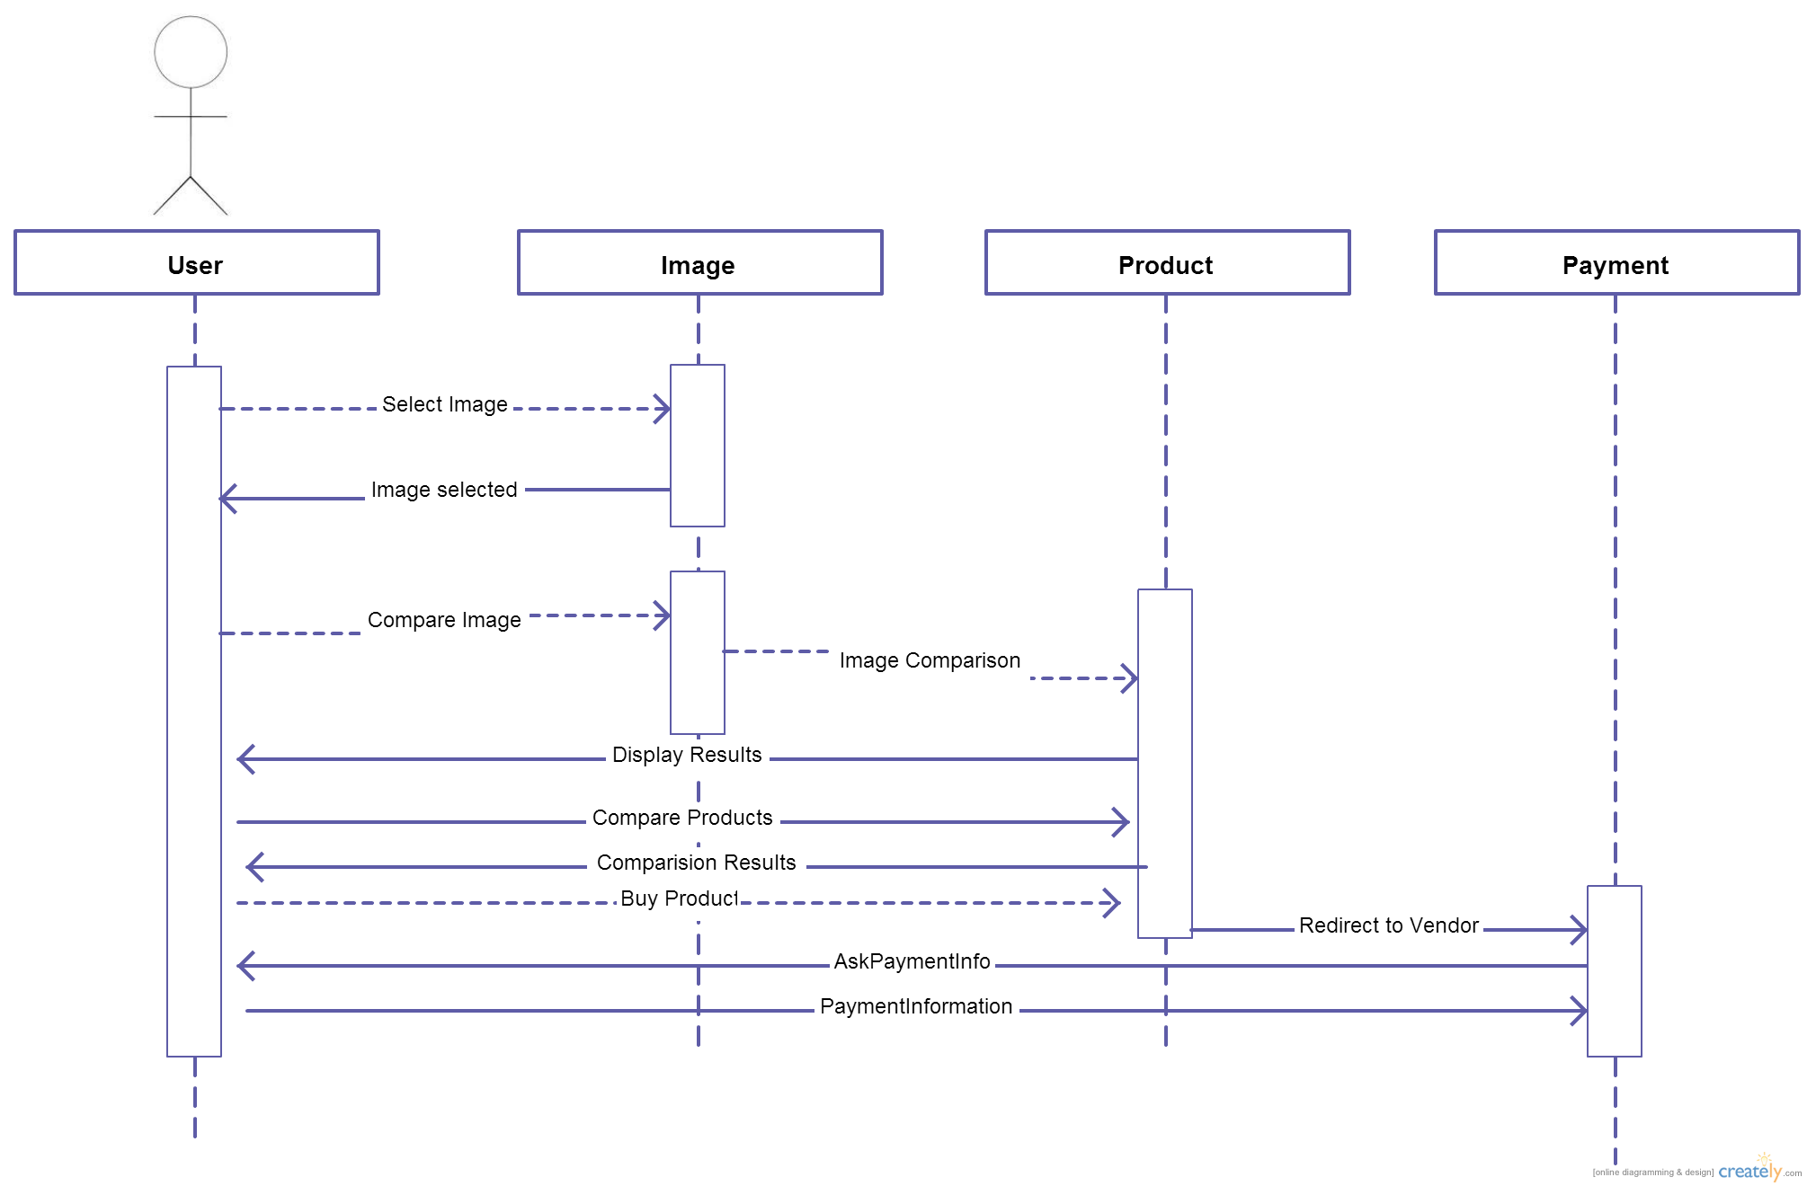
Sequence Diagram:

Slide 9
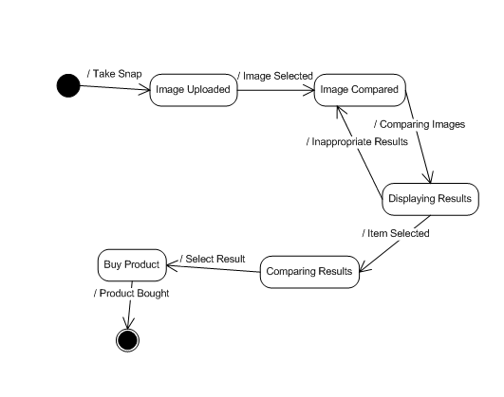
E-Commerce State Diagram:

Slide 10
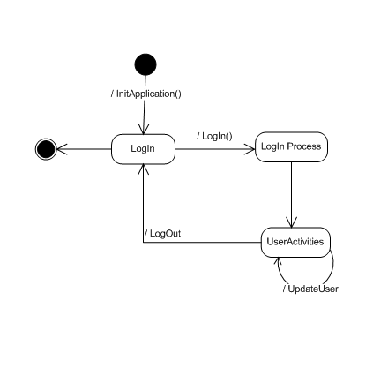
Login State Diagram:

Slide 11
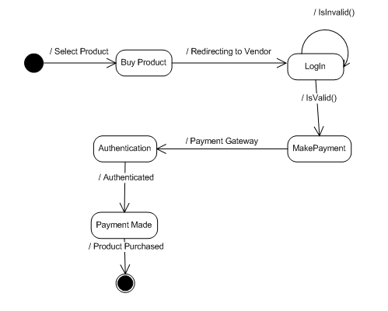
Purchase State Diagram:

Slide 12
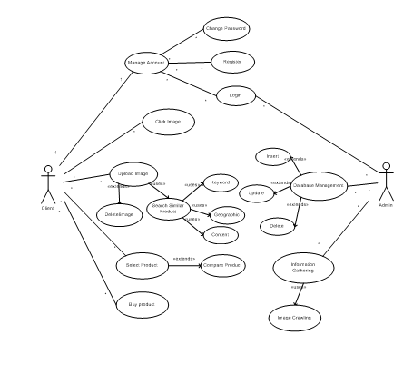
Use Case Diagram:

Slide 13
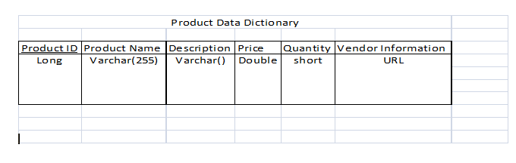
Product Data Dictionary:

Slide 14
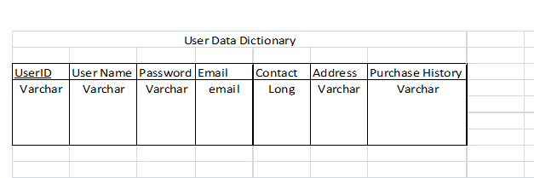
User Data Dictionary:

Slide 15
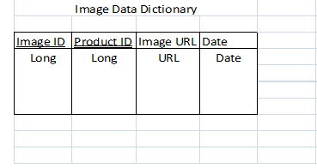
Image Data Dictionary:

Slide 16
Features & Used Technologies :
Technologies Used:
Android
J2EE
Image Processing
Image Comparison
DBMS
Features:
Search History
Product Comparison
Online Product Database
Interactive GUI

Slide 17
Requirements:
Hardware :
Android Compatible Device
WAN Connection
Camera
Software :
Android OS
Image Comparison Algorithm
Database

Slide 18
What Will We Learn?
Android Application Development
Eclipse IDE
Image Processing & Comparison Algorithm
Database Management
Image Crawling
J2EE

Slide 19
Project Outcome:
An Android Application which shall help user to simply search similar products by just taking Snap of it.
A Website featuring essential product details that shall make your search easy and quick.

